Slide 1
Structured Query Language
SQL

Slide 2
What is SQL ?
SQL (Structured Query Language) is a programming language used to communicate with and manipulate databases. It is the standard language for relational database management systems and is used to perform tasks such as updating data on a database or retrieving data from a database. SQL statements are used to store, update, remove, search, and retrieve information from the database.

Slide 3
What is Query in SQL ?
A query in SQL is a request for data or information from a database table or combination of tables.
It is a programming language designed to interact with databases and is used when companies have a ton of data that they want to manipulate.
SQL is the most well-known and widely-used query language, and anyone working at a company that stores data in a relational database can use it.

Slide 4
Why SQL is important for a website ?
SQL is an important language for web developers because it lets them interact with databases.
It’s also important for website owners to know about SQL for two reasons: You can use it to get information from your database and you can use it to create tables and organize data in your database.
Without the use of SQL, you would not be able to utilize websites how you do day today.

Slide 5

Project Tittle
TRAVEL BOOKING MANGEMENT

Slide 6
TRAVEL BOOKING MANGEMENT
Users can search for hotels based on their destination, preferences, and budget.
The system provides real-time availability and pricing information for different accommodation options.
Users can specify pick-up and drop-off locations, choose vehicle types, and view estimated fares.
Flight search functionality allows users to find available flights based on their travel dates and preferences.
Users can view detailed information about flights, including schedules, durations, and prices.

Slide 7
Entity Relationship Diagram
Hotels Table
Flights Table
Cabs Table
Itineraries Table

Slide 8
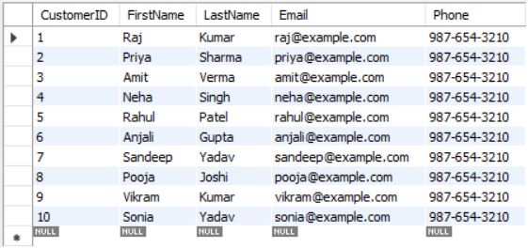
Customers Table

Slide 9
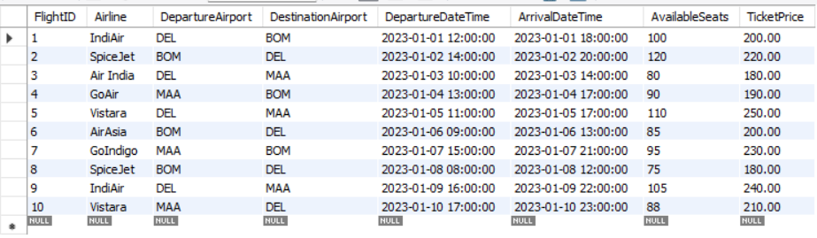
Flights Table

Slide 10
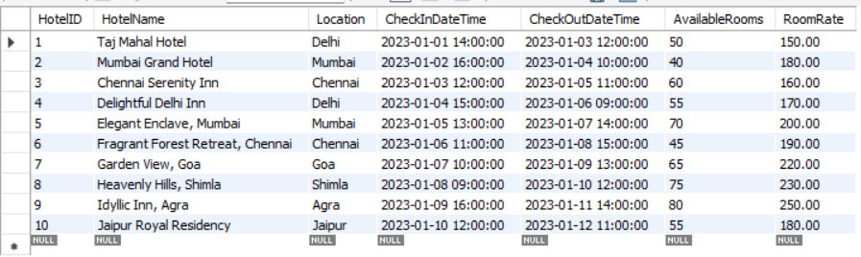
Hotels Table

Slide 11
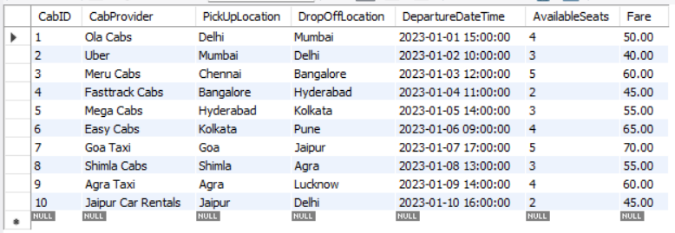
Cabs Table

Slide 12
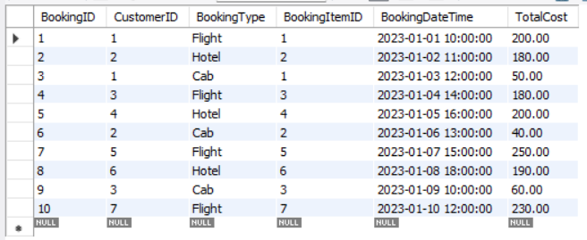
Bookings Table

Slide 13
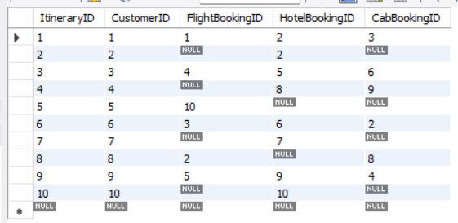
Itineraries Table

Slide 14
Flights with the highest ticket price ?
SELECT *FROM FlightsWHERE TicketPrice = (SELECT MAX(TicketPrice) FROM Flights);
Output:

Slide 15
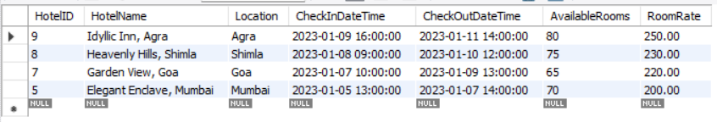
Hotels with available rooms > 60 and order by room rate in descending order ?
SELECT *FROM Hotels WHERE AvailableRooms > 60ORDER BY RoomRate DESC;
Output:

Slide 16
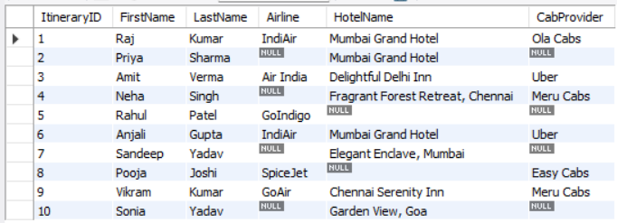
Output :

Slide 17
Customers who have made bookings, along with the total spending and the most expensive booking ?
SELECT Customers.*, COALESCE(SUM(Bookings.TotalCost), 0) AS TotalSpending, MAX(Bookings.TotalCost) AS MaxBookingCostFROM CustomersLEFT JOIN Bookings ON Customers.CustomerID = Bookings.CustomerIDGROUP BY Customers.CustomerID;

Slide 18
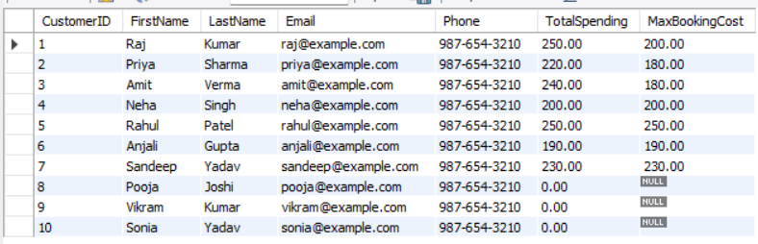
Output :

Slide 19


